Slide 1
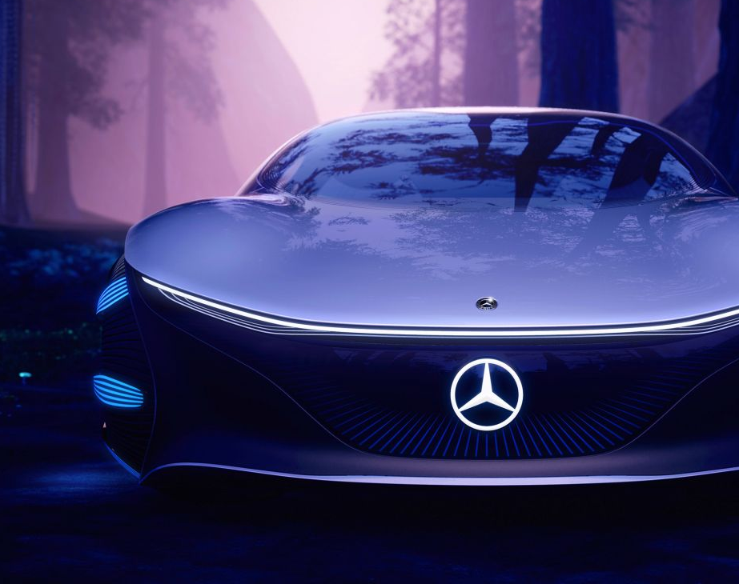
The Design Thinking and Process behind Manufacturing Cars
DTL Presentation by Krishnaraj, Pranaav, Tirth and Devanshu

Slide 2
Contents
01
02
03
04
05
06
History and Necessity
Evolution of Cars
Design Changes over the Years
Market Impact
Types of Cars and Materials
Environmental Impact

Slide 3




History Evolution and Problems Solved
Krishnaraj

Slide 4


How was life like before cars?
Up until the early 1900s, few people lived more than a few Kilometers from where they grew up. It was a matter of choice and logistics. Before cars were invented moving just a short distance away meant hours of buggy travel on rough roads. The rise of suburban areas also wouldn’t have been possible without the automobile.

Slide 5
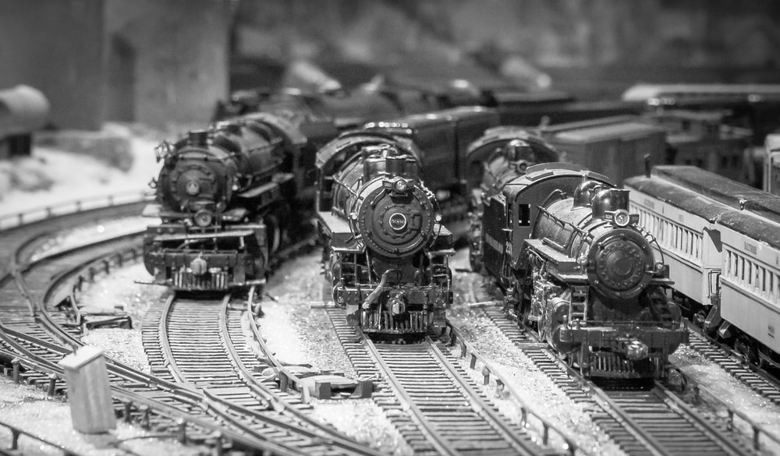
Primary Means of Travel in the Pre Car Era
Walking, horse-riding, trains and trams in cities.

Slide 6
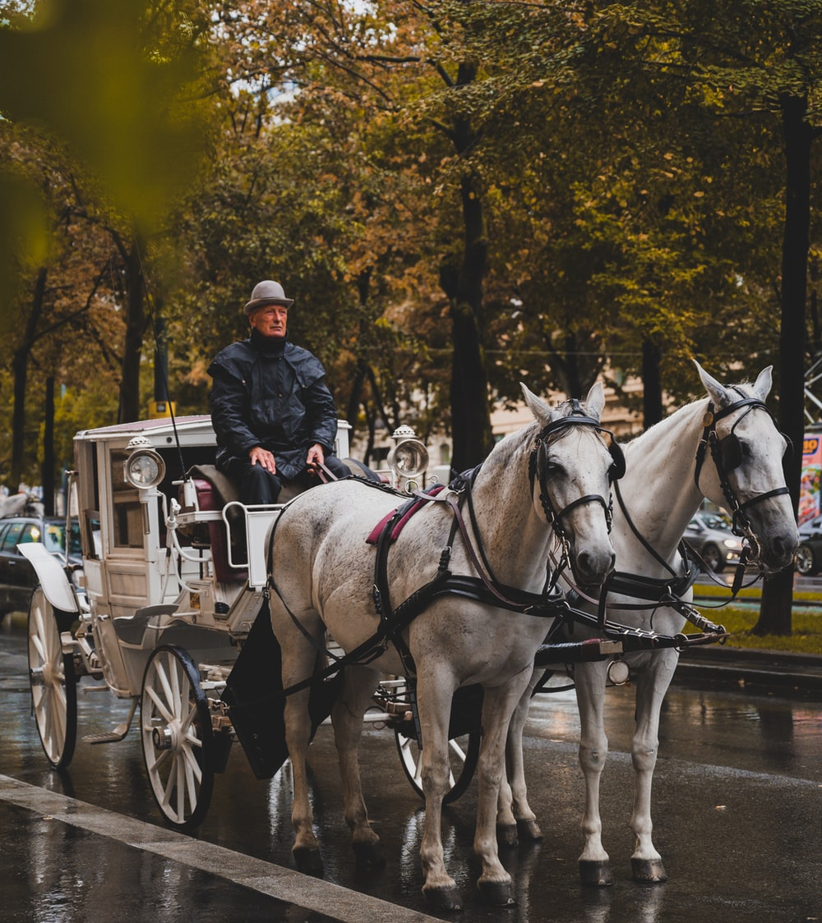
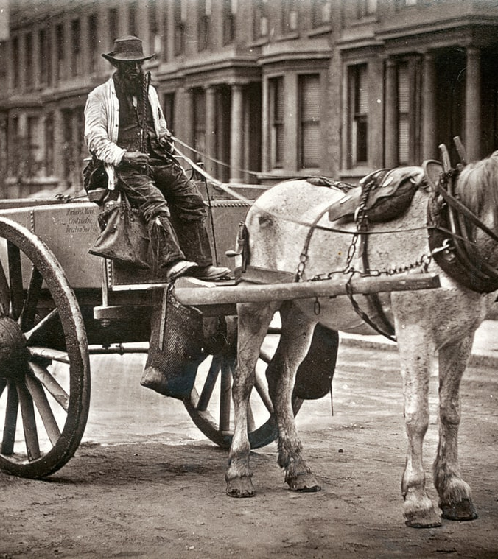
Cart > The Chariot > ‘Karros’ > Latin ‘Carrus’ > English ‘Car’

Slide 7


Impact of the Invention
The most obvious change for everyday people was that cars gave them a way to get around quickly. Suddenly, people had a new mode of transportation that could get them more places, which meant leisure travel became something common folk could afford.
Where people live has also been influenced by the automobile. Up until the early 1900s, few people lived more than a few miles from where they grew up. It was a matter of choice and logistics. Before cars were invented moving just a short distance away meant hours of buggy travel on rough roads. The rise of suburban areas also wouldn’t have been possible without the automobile.

Slide 8

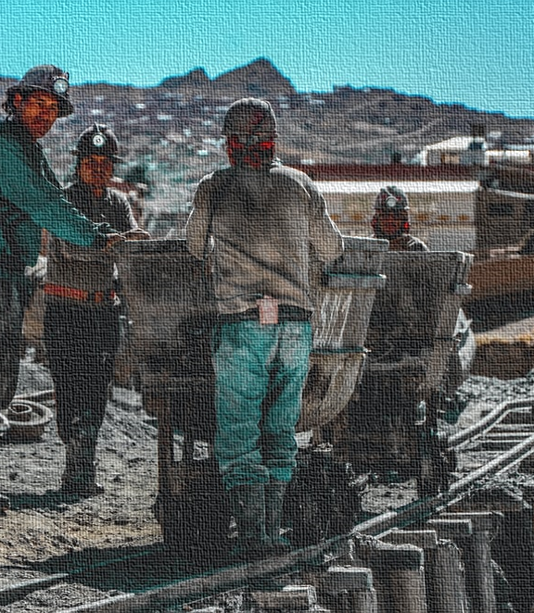
Why all this started and when
As Europeans of the 17th century switched from wood to coal as their main source of fuel, mines were deepened and, as a result, often became flooded after penetrating underground water sources.

Slide 9
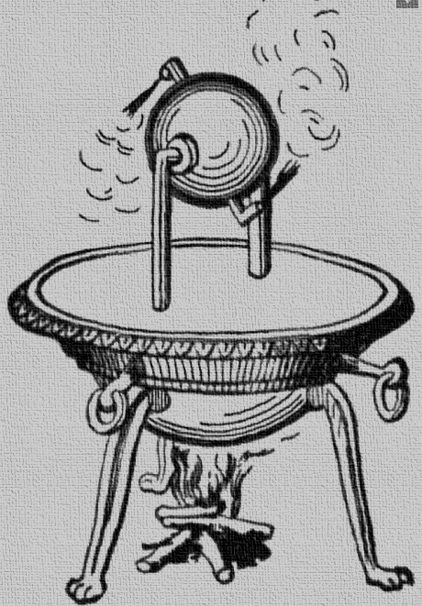
The First Solution
In 1606, de Ayanz registered the first patent for a machine that used steam power to propel water from mines.

Slide 10
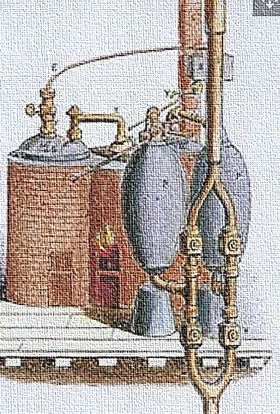
Second Solution
In 1698, Thomas Savery, an engineer and inventor, patented a machine that could effectively draw water from flooded mines using steam pressure. Savery used principles set forth by Denis Papin, a French-born British physicist who invented the pressure cooker. Papin's ideas surrounding a cylinder and piston steam engine had not previously been used to build a working engine, but by 1705, Savery had turned Papin's ideas into a useful invention.

Slide 11
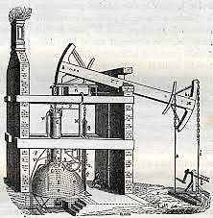
Third Solution
Luckily for European mine owners, in 1711 another Englishman, Thomas Newcomen, developed a better way to pump water from mines. His system used a redesigned steam engine that eliminated the need for accumulated steam pressure — a flaw in Savery's system that led to many an unfortunate explosion.

Slide 12
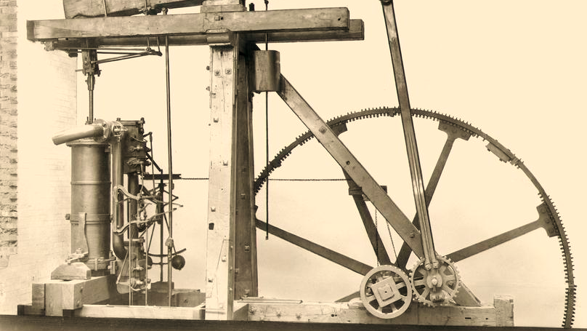
The Main Solution
But by 1765, the fate of Newcomen's engine was sealed. In that year, James Watt, a Scottish instrument maker employed by Glasgow University, began repairing a small model of a Newcomen engine. Watt was perplexed by the large amount of steam consumed by Newcomen's machine and realized that to remedy this inefficiency, he would have to do away with the constant cooling and reheating of the steam cylinder.

Slide 13
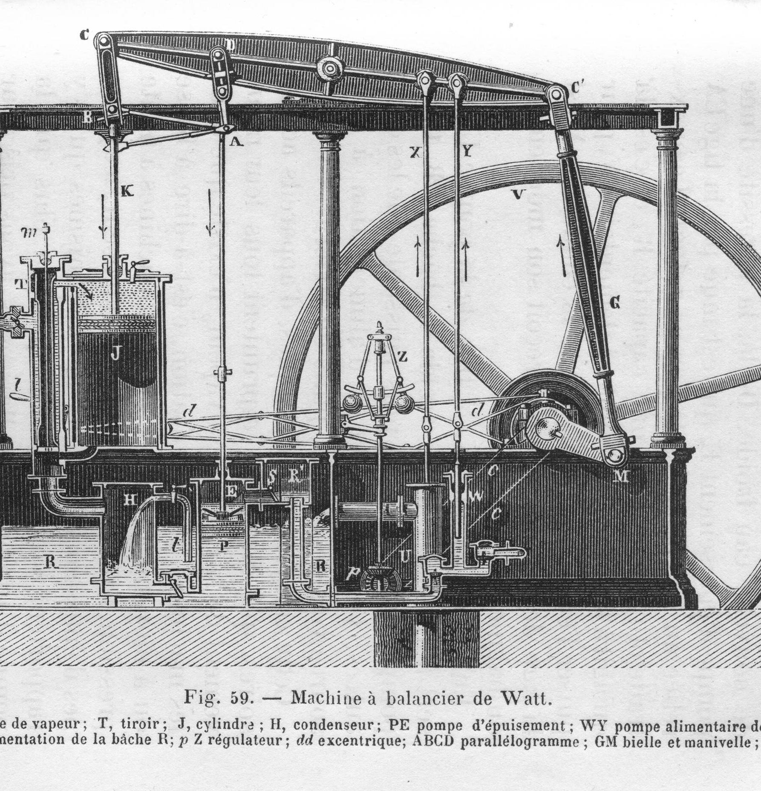
Watt’s Engine
Watt's improvements to the steam engine, combined with Boulton's vision of a nation powered by steam, facilitated the rapid adoption of steam engines across the United Kingdom and, eventually, the United States. By the 1800s, steam engines were powering mills, factories, breweries and a host of other manufacturing operations. In 1852, the first flight of a steam-powered airship took place. Future iterations of the steam engine also came to define travel, as trains, boats and railways adopted the technology to propel passengers into the 20th century.

Slide 14
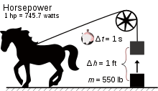
The Term HorsePower
James Watt, who invented steam engines, figured out a mathematical way to equate horses to engine power. ... Thus the term horsepower was invented. Watt measured the capability of a big horse to pull a load and found it could pull a weight of 150-pounds while walking at 2.5 miles per hour.

Slide 15
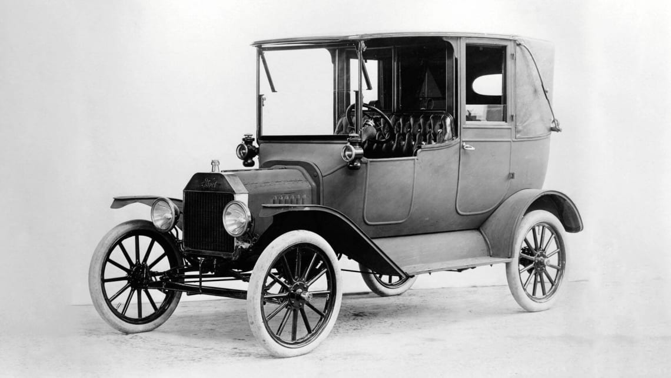
How did the first cars work?
A steam car burned fuel that heated water in a boiler. This process made steam that expanded and pushed pistons, which turned a crankshaft. An electric car had a battery that powered a small electric motor, which turned a drive shaft. A gasoline car ignited fuel that caused a small explosion inside each cylinder. This explosion pushed the piston and turned a crankshaft connected to the wheels by a chain or drive shaft.

Slide 16
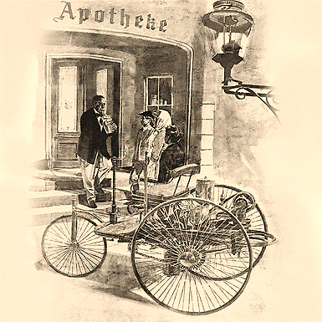
The First Car
On January 29, 1886, Carl Benz applied for a patent for his “vehicle powered by a gas engine.” The patent – number 37435 – may be regarded as the birth certificate of the automobile. In July 1886 the newspapers reported on the first public outing of the three-wheeled Benz Patent Motor Car, model no. 1.

Slide 17
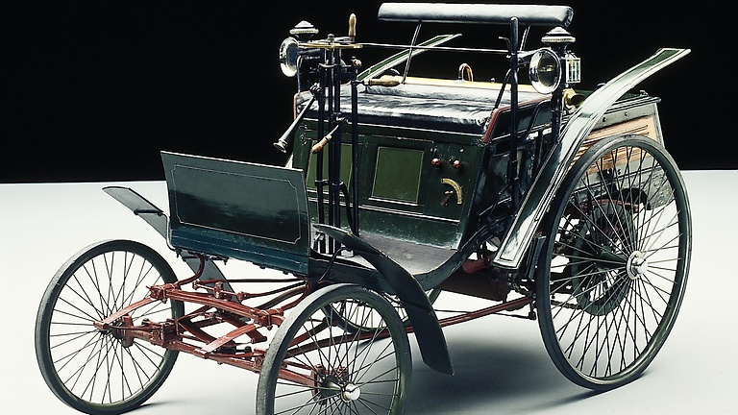
The Racing Era
The Benz Velo put on the market in 1894 became a big commercial success. It was followed by an engine-powered bus and a truck.
From the beginning, motorsport was a most important means of popularising the innovations and served mainly to demonstrate the performance capabilities of the automobiles.

Slide 18
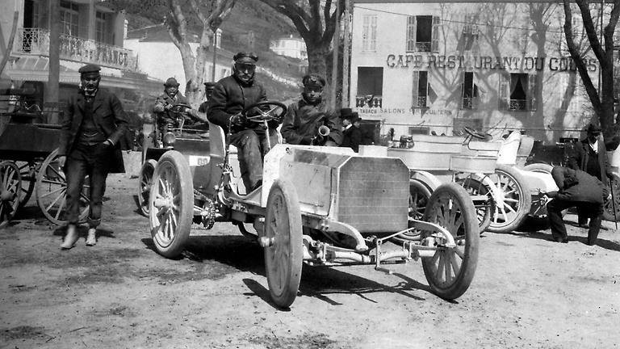
Birth of Mercedes
Daimler-Motoren-Gesellschaft laid the foundations for many more successes by constructing a racing car that was commissioned by Emil Jellinek and named after Jellinek's daughter Mercedes. In late March 1901 the new model, the Mercedes 35 hp, passed the acid test by scoring a sensational success during Nice racing week.

Slide 19

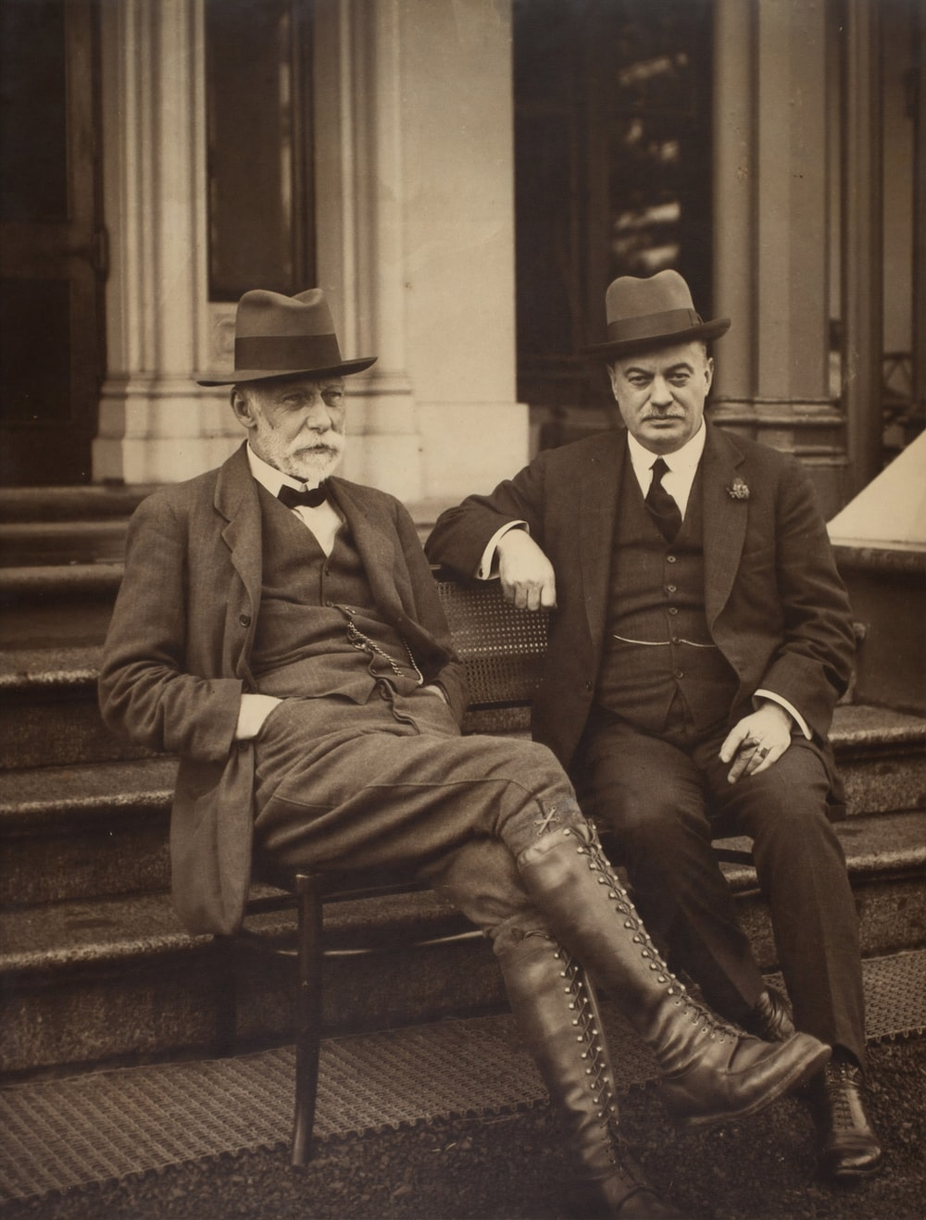
The Intended Audience for the First Car
In 1900 wealthy people bought cars for pleasure, comfort, and status. Many doctors bought small, affordable cars because they were more dependable than horses and easier to keep ready. Rural Americans liked cars because they could cover long distances without depending on trains.
A family’s house with a car in the driveway has been a common sight since about 1910. Young people liked cars because they could go to movies, restaurants, and other fun places instead of staying at home with their parents.

Slide 20
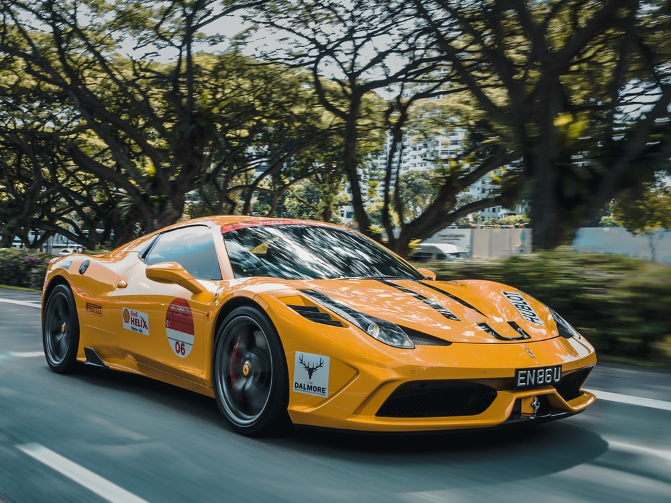
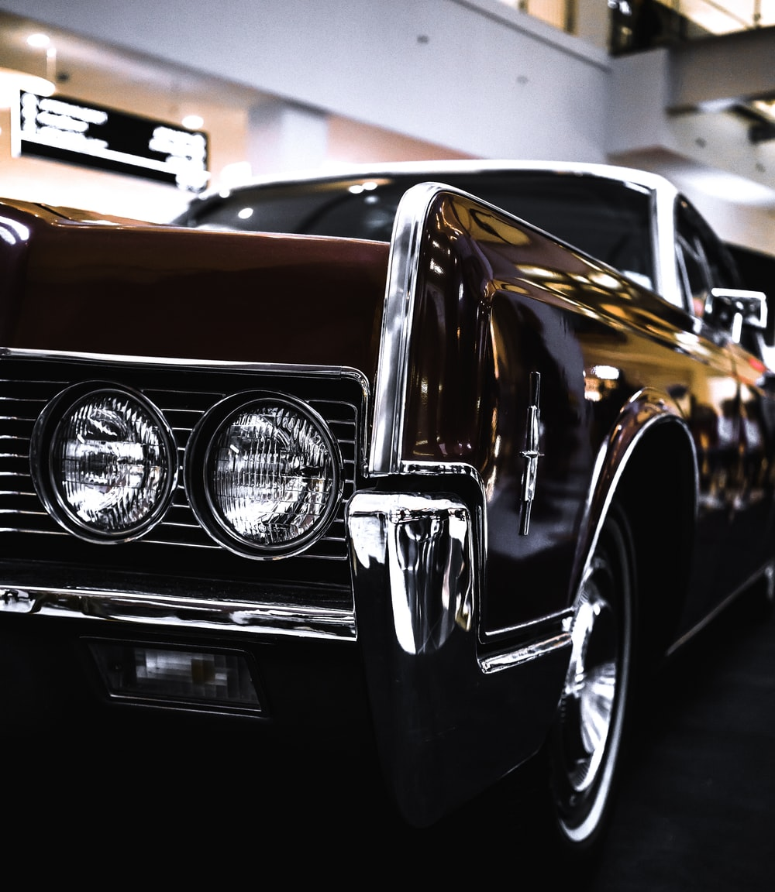
Design Changes over the Years
Pranaav Suratwala

Slide 21
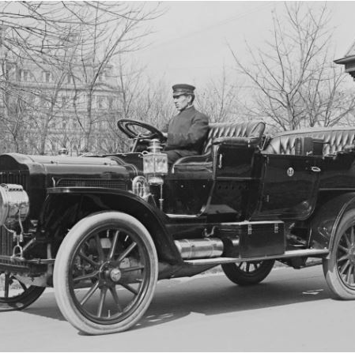
1910s
Though the first combustion engine automobiles started tooling around Europe as early as 1807, it wasn’t until Henry Ford applied the concept of assembly line production to the process that an affordable and dependable vehicle became widely available.

Slide 22
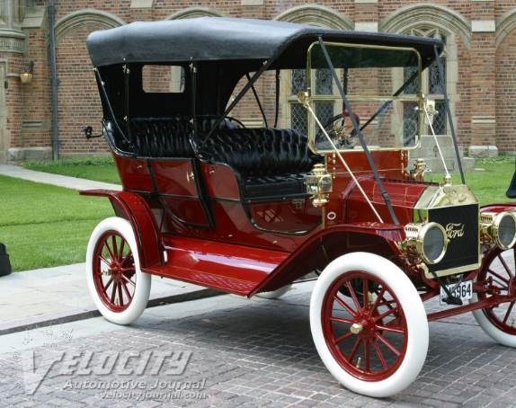
Ford Model T
The first iterations of the Model T carried over the “runabout” body style from earlier automobiles, bereft of doors, windshield, or windows and more reminiscent of horse-drawn buggies than modern automobiles to come

Slide 23
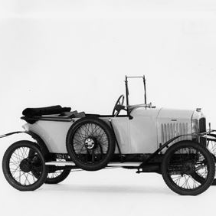
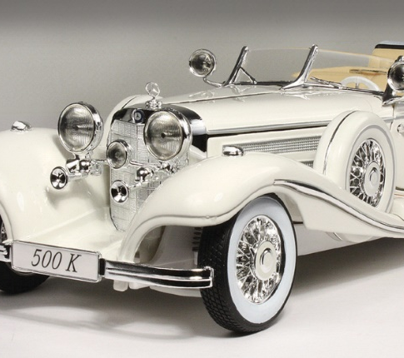
1920
Over the first quarter of the 1910’s and into the 20’s, the snubbed chassis and box-like wheelbase of the Model T and its competitors would lengthen considerably and closed-body designs would gain precedence over the open-air carriage style.

Slide 24
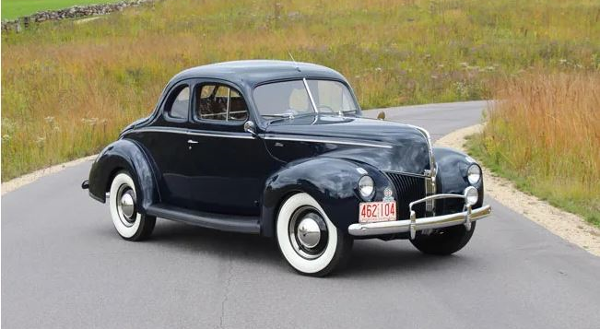

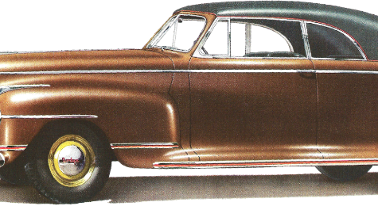
1940s
1940 Ford Standard Coupe
Though WWII was a major interruption to commercial car production, it also resulted in one of the most important car design innovations: Ponton styling. From the French for “pontoon,” this was the culmination of the decade-long trend to blend things like runner boards, headlights and fenders into a single uninterrupted form. Aerodynamically sound and visually cohesive, the bulging hoods and bulbous headlights that flowed continuously with the car’s surface also created a svelte and muscular effect that jived well with the cultural attitudes of the James Bond era.

Slide 25
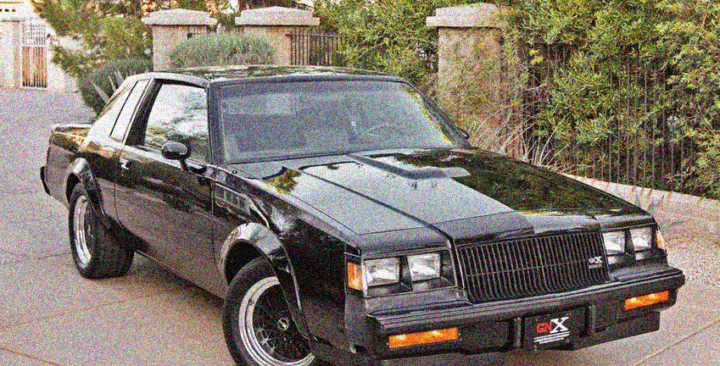
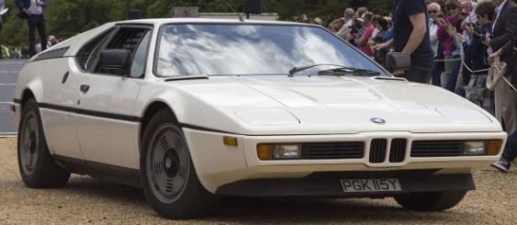
1980-1990
The 80’s saw a trend towards generic, boxy and generally uninspired car design as consumers pushed the market towards new concerns with safety and fuel efficiency. (In fact, some of the most fuel efficient, but slowest, cars of all time are from this decade). Some might call this the year that color died, as vibrant hues were ditched in favor of metallic paints as the coat of choice. In lieu of sleek exteriors, interior design and ergonomics began to be taken more seriously.

Slide 26
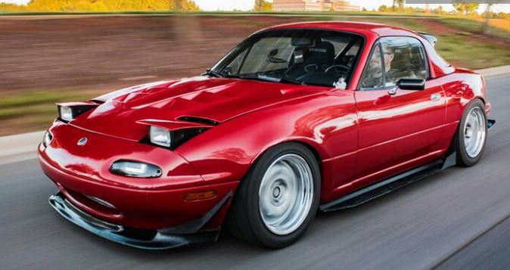
Mazda Miata
Though not all 90’s cars have aged well, there was a definite reaction to the humdrum concepts of the previous decade; fluid curves and contours had a renaissance, especially with higher-end sports cars. The wedge-shaped sports cars and breadbox sedans of the 80’s were being phased out in favor of the elegant lines of the 30’s and 60’s, indicative of the cyclical tastes of the automotive community.

Slide 27
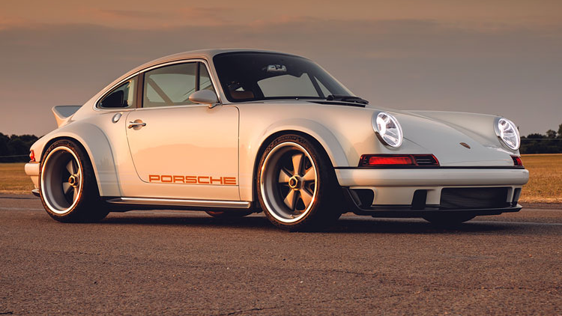
2000-2020
The aughts saw an explosion of car design in all shapes, forms, and styles, making it difficult to track down a common thread in their look. The variety in form has not translated to a variety in hues: white, silver, black, and gray are the most popular exterior colors of the day. However, it’s undeniable that the preeminence the SUV was cemented over the course of the last decade, in many ways replacing the elegant sedans and roadstersa of decades gone by.
Also we got to see new style and look in this century. American muscle, Japan Sleepers, The Germans and Italians all changed the automobile industry drastically.
Analyzing the changes in design over the decades, we can say that the automobile industry has revolutionized and has come a long way.

Slide 28
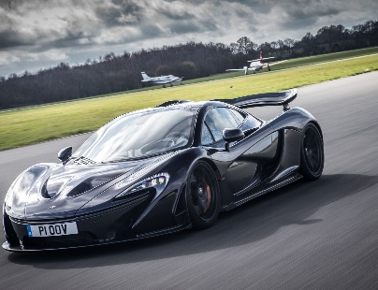
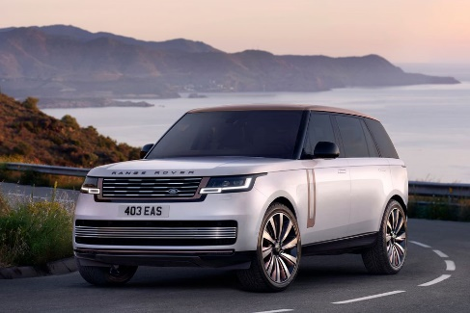
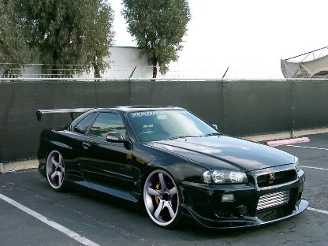
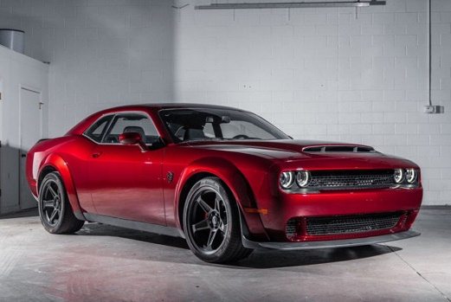
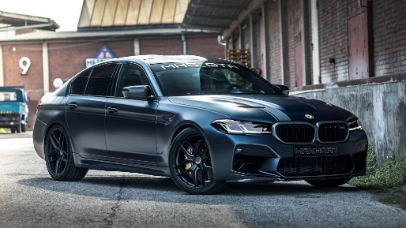
Modern Day Cars

Slide 29
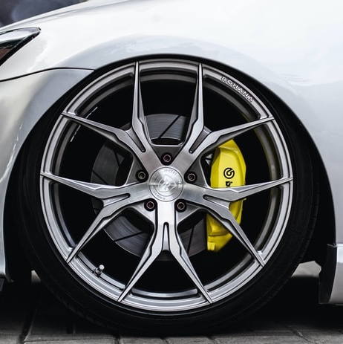

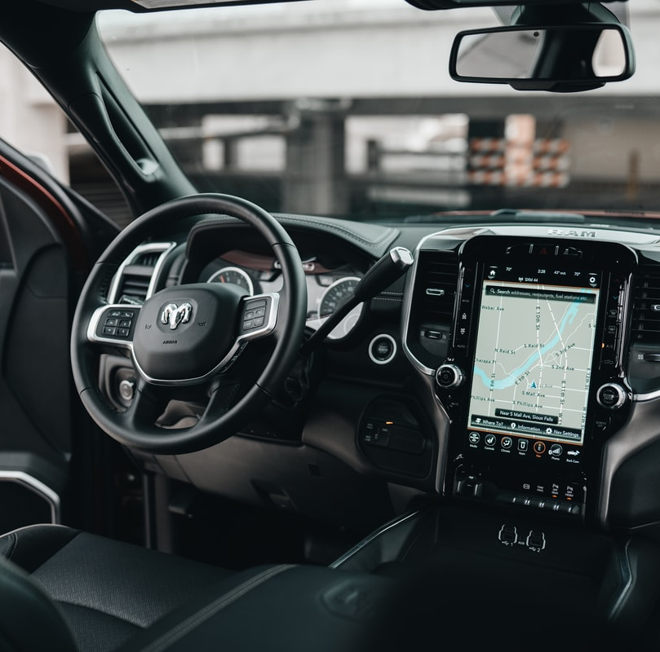
Specifications

Slide 30
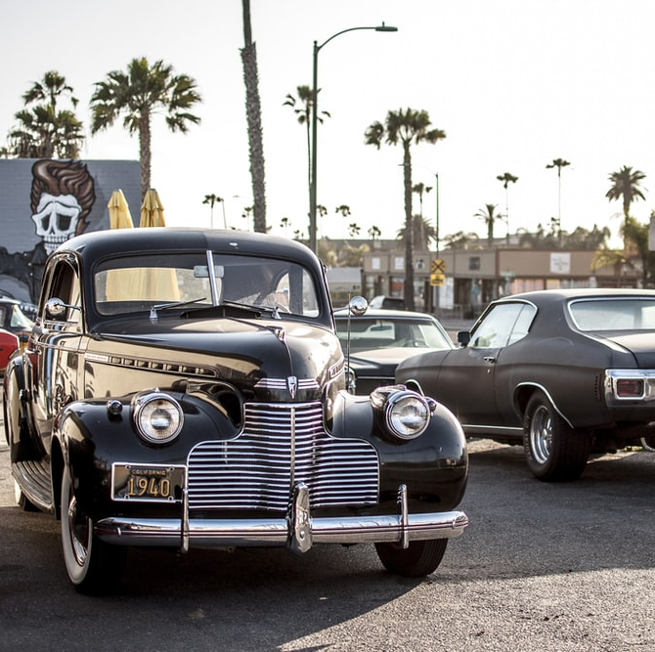
20th Century
Most of the cars built before the 1940s were under 100 hp with maximum rpm up to 4000rpm with torque up to 250-280 NM.
As we enter late 90s in the world dominated by Germans with Maercedes and BMW both companies reinvented their cars and boost their maximum horsepower to 200hp and other features like inbuilt music system, 4 wheel drive, air bags for safety, short gears to achieve maximum speed and 5- speed manual transmission. Mostly all big car companies were in a race to producing the fastest and powerful car.

Slide 31
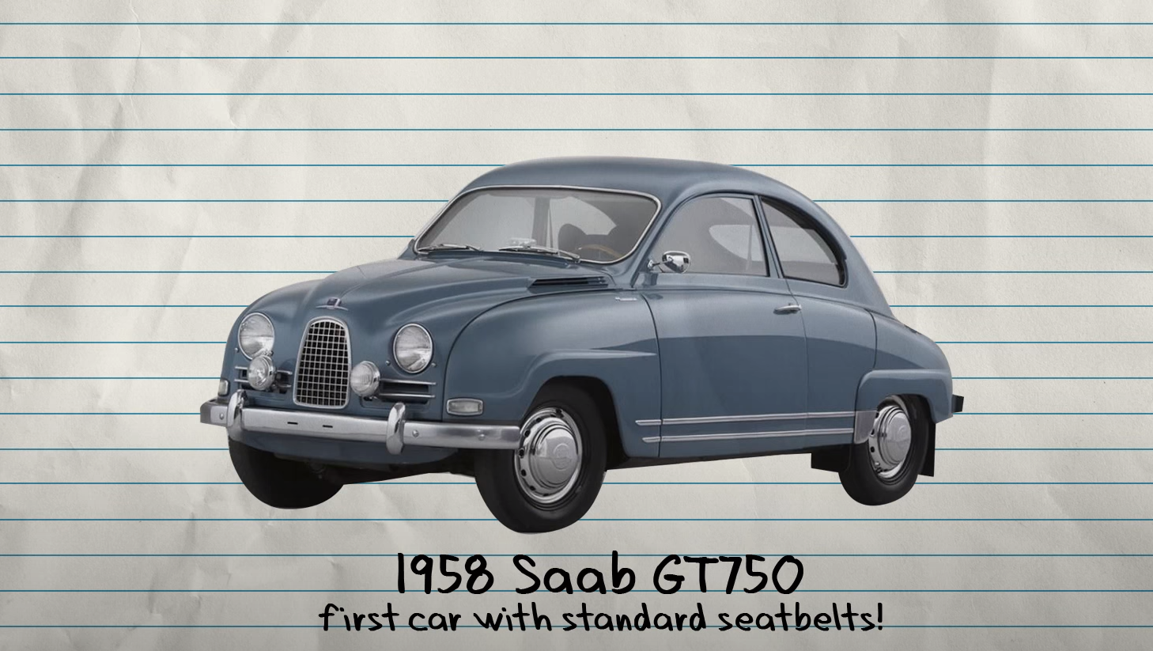

Slide 32
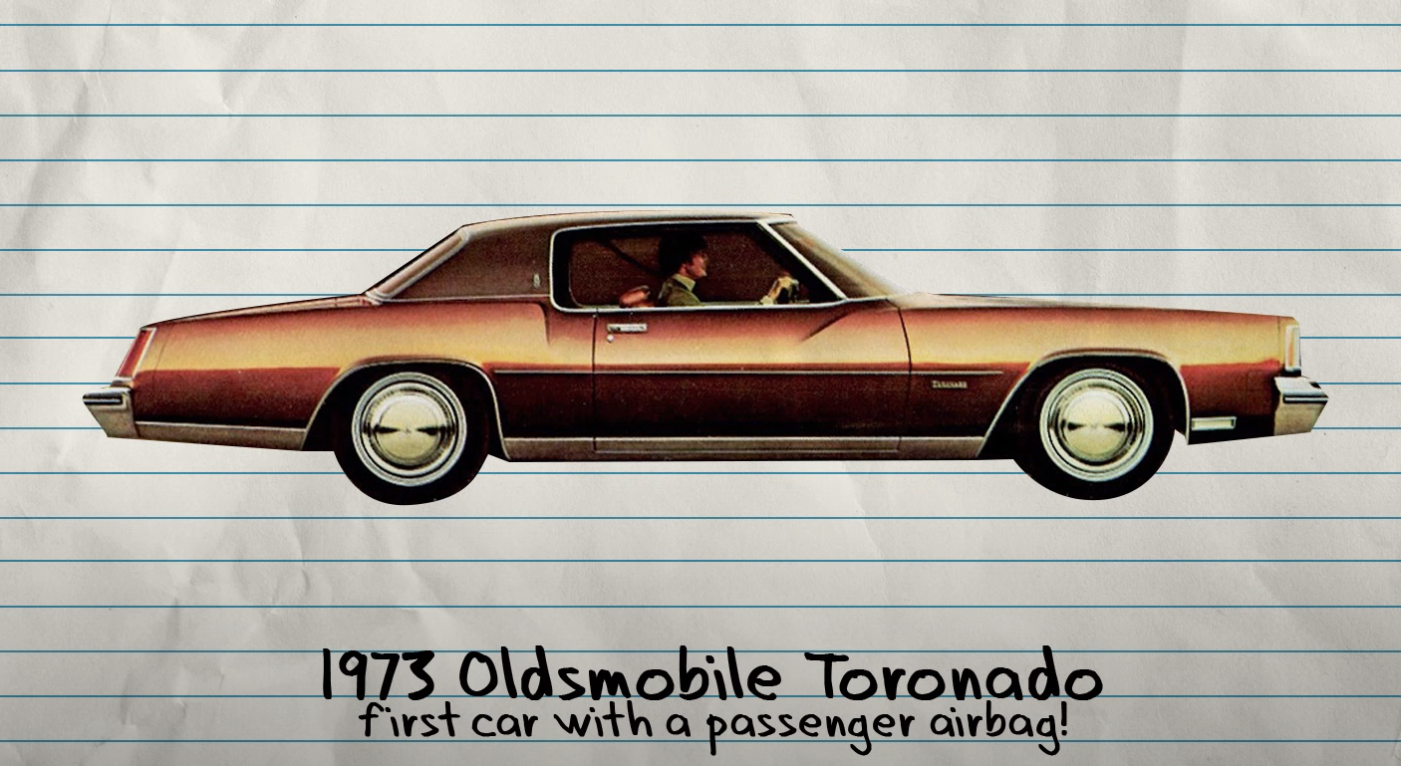

Slide 33
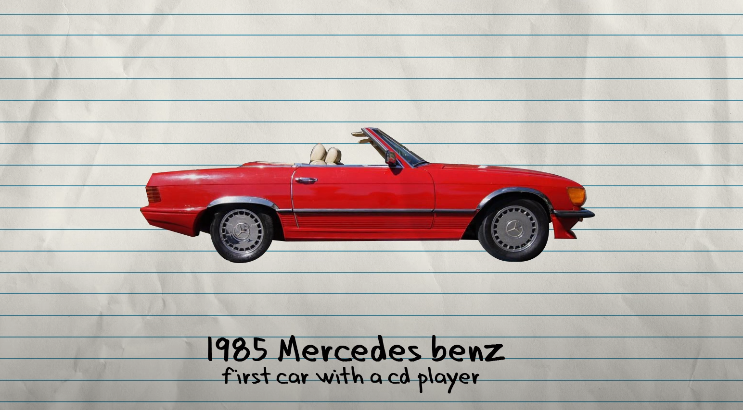

Slide 34
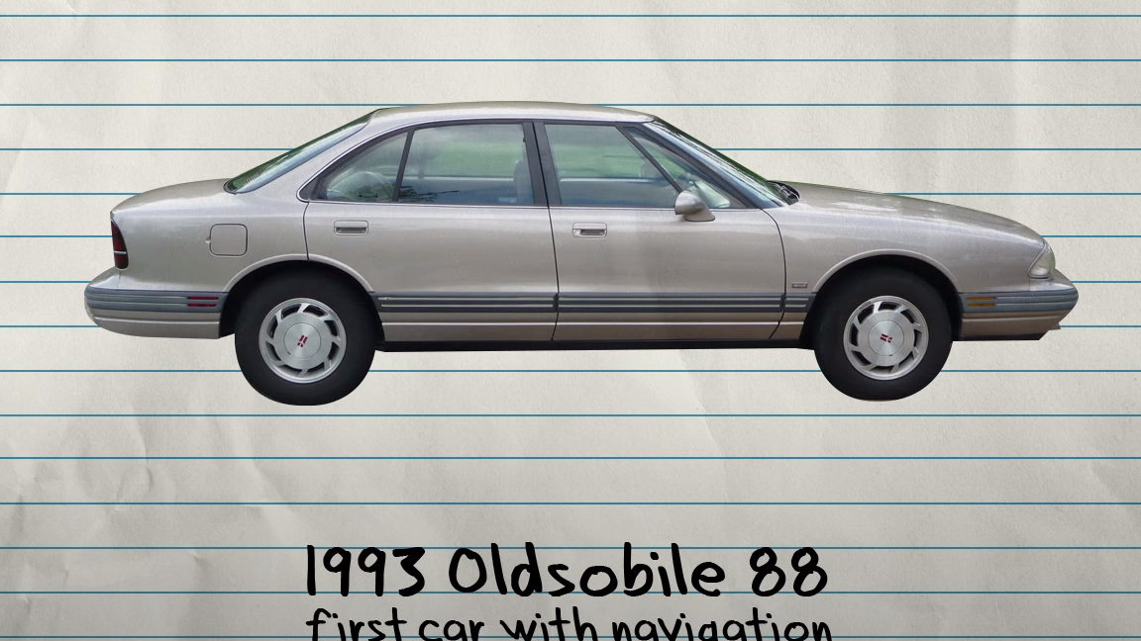

Slide 35
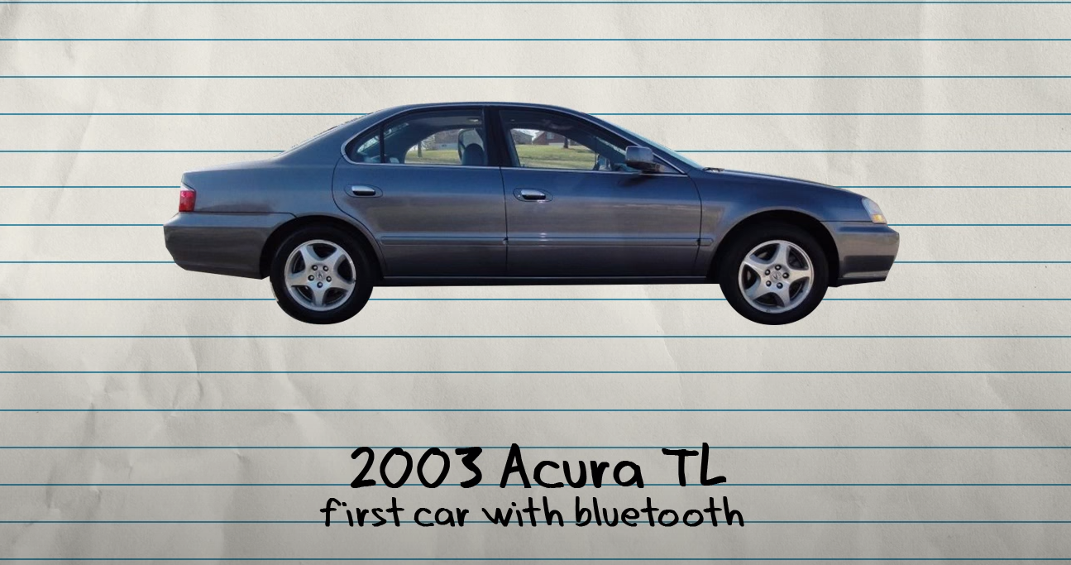

Slide 36
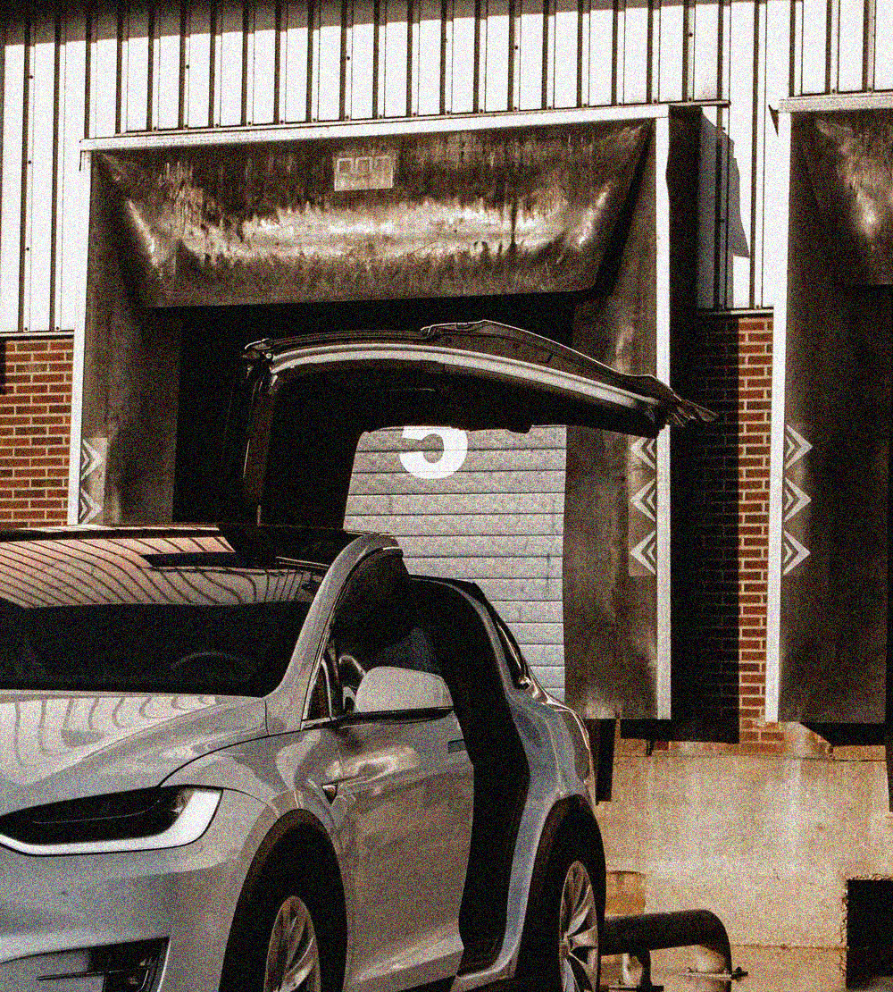
Tesla and Electric Cars
Tesla, an Automobile company founded by Elon Musk produces Electric vehicles, as he believes it is the new future of Automobile industry and it is cost effective and has low maintenance compared to cars consuming fuels. His 4 basic models include model S 3 X Y, all these cars are full electric

Slide 37
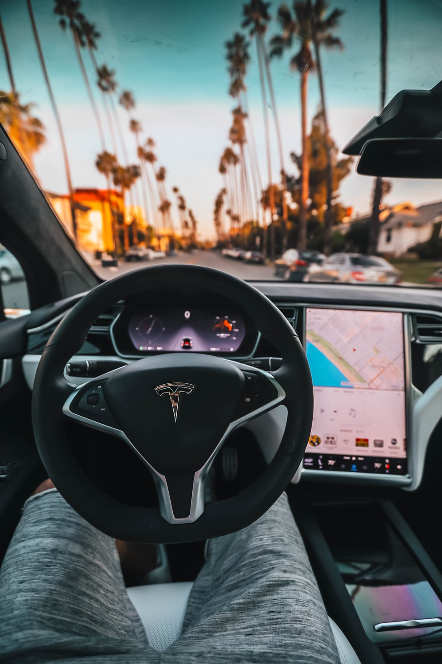
Autopilot
Autopilot AI team drives the future of autonomy of current and new generations of vehicles. Learn about the team and apply to help accelerate the world with full self-driving.
This car comes with standard advanced hardware capable of providing Autopilot features, and full self-driving capabilities—through software updates designed to improve functionality over time

Slide 38
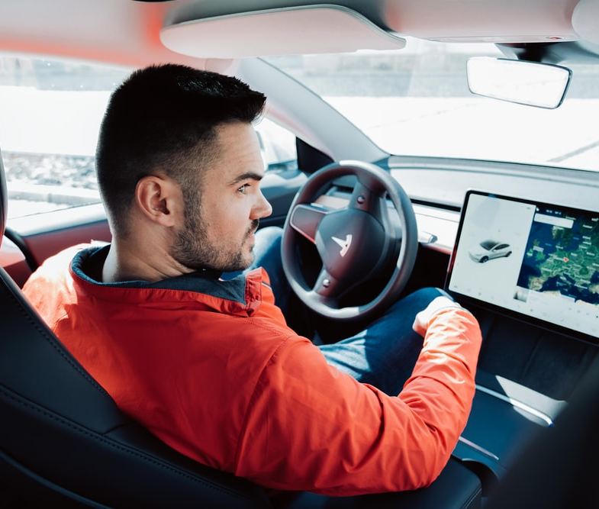
Touchscreen
The touchscreen to control many features that, in traditional cars, are controlled using physical buttons (for example, adjusting the cabin heating and air conditioning, headlights, etc.). One can also use the touchscreen to control media, navigate, use entertainment features, and customize Model S to suit your preferences. The main component of the touchscreen is the map area.

Slide 39
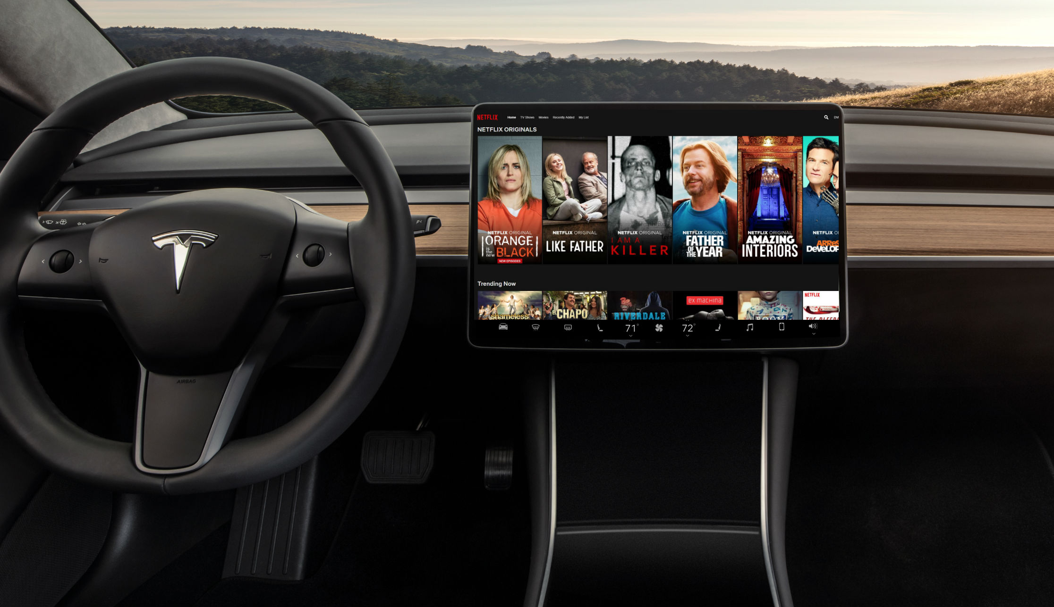
Streaming services
The high-tech touch screen also allows you to stream your favorite shows from inside your Tesla. But, like the caraoke feature, you have to be parked for this feature to work.

Slide 40

Sentry mode
Sentry mode allows you to keep a close eye on your parked vehicle from anywhere in the world. Let's say someone hits your car with a shopping cart, your Car will start recording from the outside cameras and alert you that your vehicle has been hit through the Car app. This feature eliminates the stress of ever wondering where that mysterious dent came from.

Slide 41

The Apps
One of the most interesting things about Tesla is the app, which allows drivers to control their car from virtually anywhere. The app sends real-time updates if sentry mode were to activate. You can also check the status of your vehicle while it's charging, control the air conditioning and heat, and also lock and unlock your car.

Slide 42

Aerodynamics

Slide 43
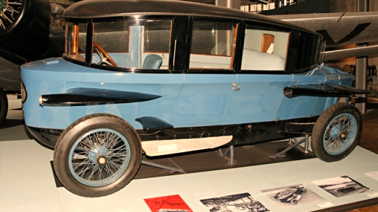

Slide 44
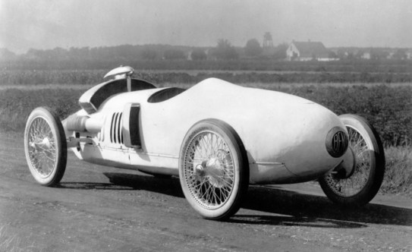

Slide 45
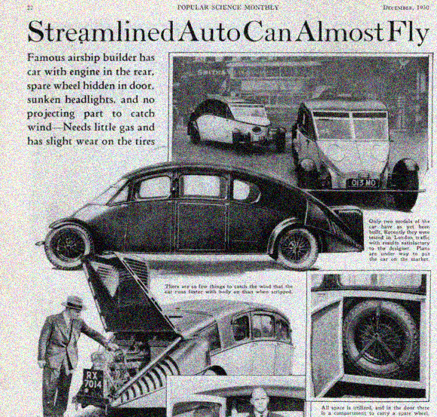

Slide 46
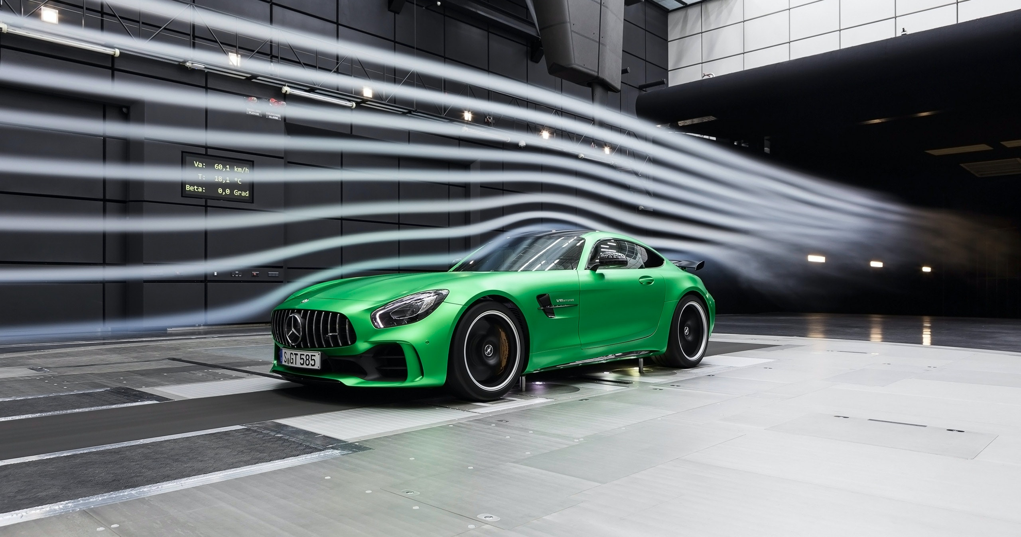

Slide 47

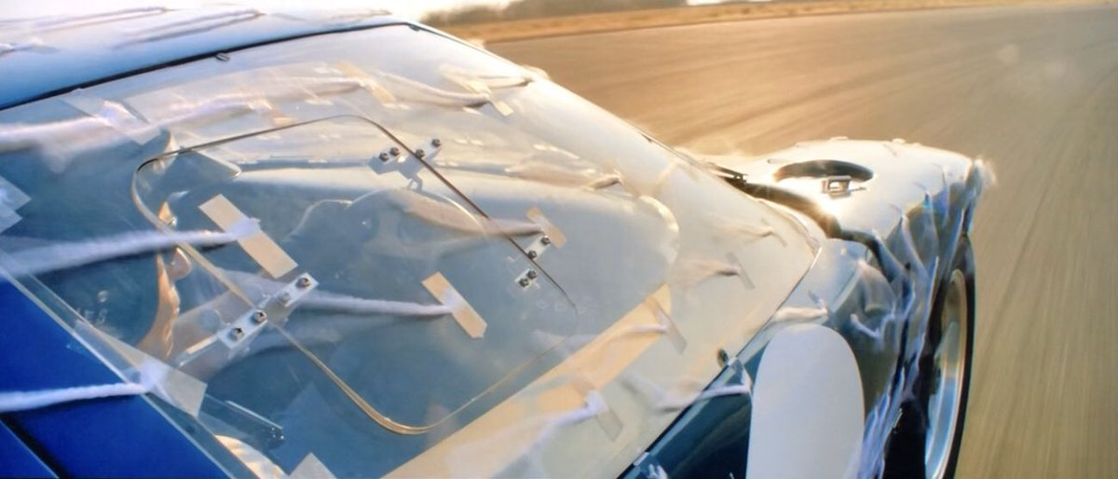
Reducing Drag without Simulations

Slide 48


Pricing, Maintenance and Availability
Devanshu Surana

Slide 49


Slide 50


Slide 51


Slide 52


Slide 53


Slide 54


Slide 55

Pricing and Fuel
With engine technology, design, and controls advancing, geometric CR continuously increased from 1980 until the present, despite average gasoline AKI dropping slowly and exhaust emission regulations tightening considerably. A great many technologies contributed to this CR increase, including low-deposit-forming fuels; electronic spark timing; precise control of EGR; 3-, 4-, and 5-valve per cylinder designs; variable valve timing and lift; sequential port fuel injection; direct fuel injection; cylinder, piston, and combustion volume design; and other combustion control techniques.

Slide 56
Economy
Automobile industry contributes 4 of the national GDP and accounts for 5 of the industrial output in India. It is moreover, a major employment generator in the country. The Indian automobile industry provides employment to around 13 million people directly or indirectly at present, a number that is likely to double by 2016

Slide 57
Growth over Time
One of the best things to happen for the Indian automobile market in the recent years was its telling improvement in the export sector. There was a 56% growth in exports from 2003 to 2004. Although economy cars continue to hold the lion’s share of the export market, vehicles worth more than USD 1 billion were also exported in 2004, for the first time in history.

Slide 58

Use of Materials over the Years

Slide 59

Use of Materials over the Years
1. The body of the 1921 Rolls Royce Silver Ghost is completely copper.
2. The Tesla Roadster is also the first commercially available automobile powered by an electric motor powered by a copper rotor.
3. In 1948, the average family car contained only about 55 wires amounting to an average total length of 150 feet. Today's luxury cars, on average, contain some 2000 copper wires adding to few kilometers in length.
4. Exxon added copper in their lubricants to make engines run smoother and last longer.
5. There are copper-carbon bushes and for dry lubrication applications.

Slide 60


Advantages and Environment Impact
Tirth Thesiya

Slide 61


Health and Emergencies

Slide 62


Privacy.

Slide 63


Safety.

Slide 64


Save Time

Slide 65


Take Pleasure Trips

Slide 66






Types of Cars

Slide 67

Sedan

Slide 68

MPV/Minivan

Slide 69

SUV

Slide 70

Pickup Truck

Slide 71

Jeep

Slide 72

Sportscar

Slide 73

Limousine

Slide 74

Electric Car

Slide 75


Market Leaders

Slide 76
Environmental Impact
Global Warming
Car pollution is one of the major causes of global warming. Cars and trucks emit carbon dioxide and other greenhouse gases,
Air, Soil and Water
The effects of car pollution are widespread, affecting air, soil and water quality. Nitrous oxide contributes to the depletion of the ozone layer, which shields the Earth from harmful ultraviolet radiation from the sun.
Human Health
Particulate matter, hydrocarbons, carbon monoxide and other car pollutants harm human health. Diesel engines emit high levels of particulate matter, which is airborne particles of soot and metal. These cause skin and eye irritation and allergies, and very fine particles lodge deep in lungs, where they cause respiratory problems.
Reducing Car Pollution
There are several ways that car and truck owners can reduce the effects of car pollutants on the environment. Old and poorly maintained vehicles cause most pollution from cars, but electric, hybrid and other clean, fuel-efficient cars have a reduced impact.

Slide 77

How Recycling Reduces Environmental Impact

Slide 78
Catalytic Converters
Catalytic converters convert the dangerous gases produced by your car into exhaust. They’re made using some of the most precious materials on earth, including platinum and palladium, as well as copper, nickel, cerium, iron and manganese. By recycling materials like this, we can reduce the need for mining and using even more of the earth’s precious resources.

Slide 79
2) Wiring Harnesses
Copper is one of the most in-demand natural resources, and the demand is only growing. Copper is used throughout the auto industry for wiring, and large amounts of copper are used in the wiring for hybrid vehicles, which are becoming more popular.

Slide 80
Engine Block and Transmissions
Aluminum is used in your car’s engine blocks and transmissions because it’s a fast, safe and cost-effective way to boost fuel economy and reduce emissions. Aluminum is also highly recyclable – up to 90% of the aluminum in your car can be recycled. Recycling just one ton of aluminum can save the energy equivalent of up to 21 barrels of oil.

Slide 81
4) Body & Frame
Up to 85% of your car can be recycled, and a large part of that is your car’s body and frame. We recycle your car’s body and frame to use it for scrap metal – that is, metal that can be re-fabricated and turned into a new item. This reduces the need for producing more metals, and reduces the amount of energy needed to produce new car parts and other items.

Slide 82

Prepared By:
Krishnaraj PT Presentation And Overview
Tirth Thesiya Advantages, Types and Market Leaders
Pranaav Suratwala – Design Changes over the Years and Engines
Devanshu Surana – Pricing, Maintenance and Availability

Slide 83

Thanks for listening!

